Slide 1



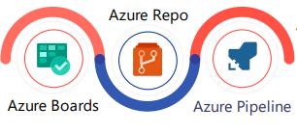







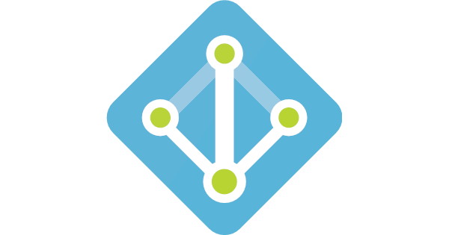
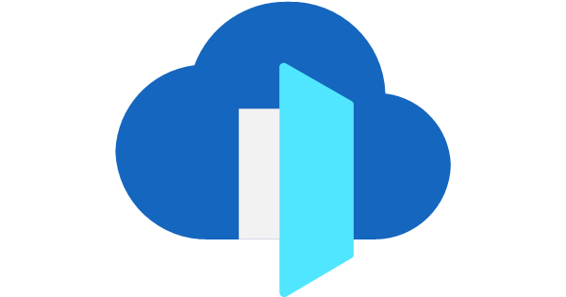








Deployment Architecture
Azure
Azure DevOps
AKS Cluster
Automated
Releases
Public IP
Container Registry
API Management
NGINX Ingress Controller
Azure PostgreSQL DB
AAD
Front Door
WAF
Pump UI
User
Pump API
IoT Device
Azure
Cosmos DB
Azure AD
Azure Key Vault
Azure
Blob Storage
Azure Monitor
React + VUE
.NET Core API
10,000 assets
Azure PostgreSQL & Cosmos DB
Azure
AKS

